Slide 1



Hexaware CODE&RISE PROGRAM
QuantumPirates_Velammal_Inst
"Unlock Potential with Precision Assessments"

Slide 2
Team Details
Team Name : QuantumPirates_Velammal_Inst
`
Application Name : Assessment Platform
Team Members
Email ID
PREMKUMAR S
premkumar25122003@gmail.com
SATHISHKUMAR R
rsathishkumar3211@gmail.com
CHANDRASOODAN R
chandrasoodanrajendiran@gmail.com
ABINESH S
aswinabinesh04@gmail.com

Slide 3

Impact/Potential Value of the Application
The platform automates many aspects of the assessment process, reducing the need for manual oversight and speeding up evaluation.
AI-driven proctoring allows for continuous supervision, minimizing the need for human proctors and enabling immediate action if issues arise.
AI algorithms detect and prevent dishonest behavior, ensuring that assessments are fair and credible.
AI-driven evaluation ensures that all candidates are assessed under the same conditions, reducing the risk of bias and human error.
Immediate alerts and interventions can help address any issues during the assessment, improving the overall experience for candidates.

Slide 4
The Solution Proposed by your Team
Solution Highlights:
The Custom Question Upload System will have an easy-to-use interface with supportfor LaTeX and a rich text editorfor multimedia formatting to facilitate the creation and management of different question kinds.
Bulk uploads with data validation and real-time error management will be supported. Questions will be categorized by topic and difficulty by NLP algorithms, with manual overrides and ongoing learning forincreased accuracy.
To guarantee secure examinations,the AI proctoring system will have sophisticated capabilities like motion analysis, gaze tracking, and extension blocking.
It will give teachers thorough feedback and analytics so they can improve learning results and adjustto the demands of the job.
Key Features / Approach:
Custom Question Upload System
Bulk Uploads
Categorization
AI Proctoring System
extension blocking
Motion analysis
gaze tracking
Feedback & Analytics
Student Tools
SWOT Analysis
Performance Metrics

Slide 5
Technologies Used
Front-End Development:
HTML5
CSS3
JavaScript
React or Angular
Rich Text Editor
TinyMCE
LaTeX Support (MathJax or KaTeX)
Back-End Development:
Node.js
RESTful APIs
Text Classification
Hugging Face Transformers
Computer Vision and AI:
OpenCV
Dlib
TensorFlow
Security Solutions:
Custom-built Extensions or Existing Security Solutions.
Data Visualization and Analytics:
Power BI
D3.js
Databases
PostgreSQL
MongoDB

Slide 6
Gen AI Tool Utilization
GPT-4 (OpenAI)
Purpose: To generate sample questions, educational content, and detailed feedback.
Hugging Face Transformers
Purpose: For natural language processing tasks like text classification, summarization, and question categorization.
OpenAI Codex
Purpose: To automate question creation and formatting, and integrate with LaTeX for mathematical content.
IBM Watson
Purpose: For advanced NLP, machine learning, and data analysis to assist with content analysis and error detection.
TensorFlow
Purpose: To develop and deploy machine learning models for analyzing proctoring data and enhancing system functionality.
OpenCV
Purpose: For motion analysis and image processing in the AI proctoring system.
Dlib
Purpose: To assist with facial recognition and gaze tracking for the AI proctoring system.
PostgreSQL or MongoDB
Purpose: For reliable database management, storing questions, user data, and metadata.
Node.js
Purpose: To handle backend server operations and API interactions for both systems.
TinyMCE
Purpose: For rich text editing and LaTeX support in the Custom Question Upload System.
Power BI or D3.js
Purpose: For creating and visualizing performance metrics and analytics dashboards.

Slide 7
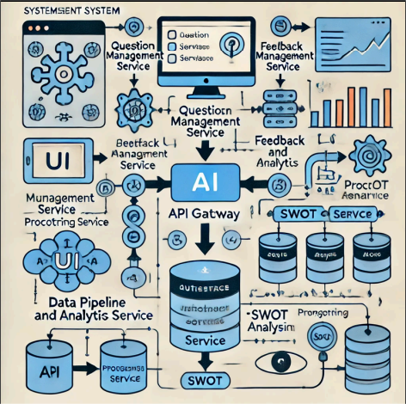
System Architecture, Functionalities and Design Diagram
.

Slide 8
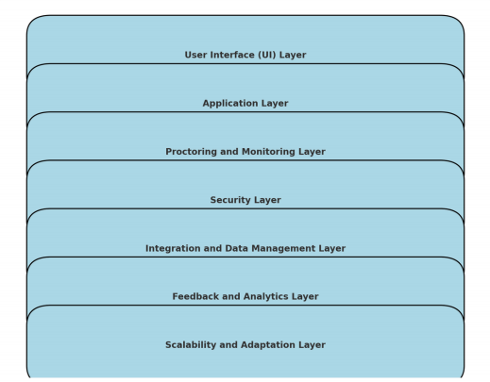
How it works
Functional Architecture:

Slide 9
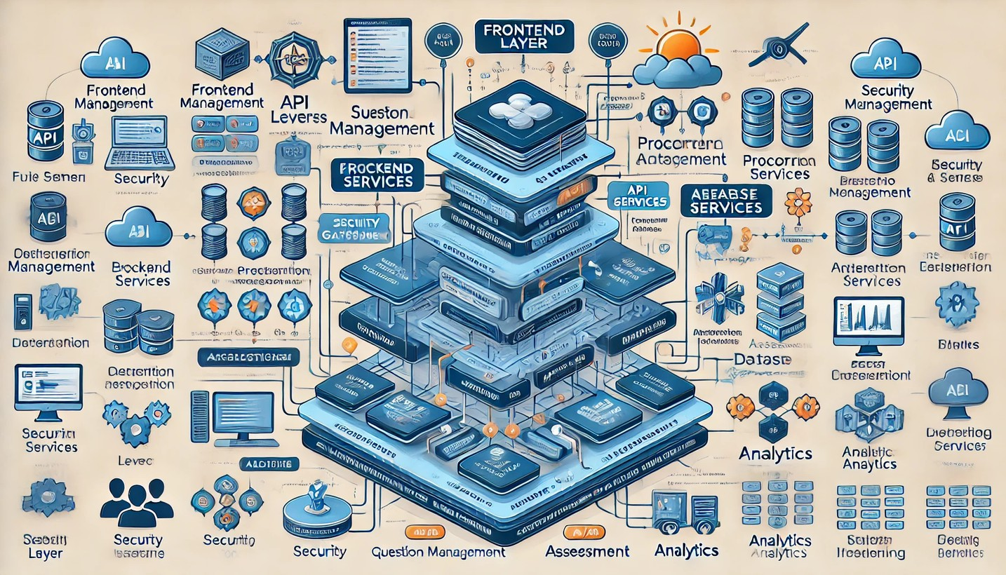
How It Works
Technical Architecture

Slide 10
Innovation and Creativity
1. Adaptive Question Generation:
Innovation: Utilizes advanced Generative AI models like GPT-4 and T5 to automatically create diverse and contextually relevant questions. This ensures a wide variety of question types and difficulty levels, tailored to individual needs.
Creativity: Incorporates NLP algorithms to categorize questions by topic and difficulty, allowing dynamic and personalized assessments.
Real-Time Automated Feedback:
Innovation: Implements AI-driven feedback systems to provide immediate, personalized responses to student submissions, improving learning efficiency and engagement.
Creativity: Uses models like GPT-4 and GPT-Neo to generate detailed and context- aware feedback, which adapts to the student’s performance over time.
Enriched Content Creation:
Innovation: Employs Generative AI tools to automatically generate supplementary materials, such as explanations and examples, enhancing the quality and comprehensiveness of questions.
Creativity: Leverages T5 and BERT for crafting content that not only supports but enriches the assessment experience.
Advanced AI Proctoring:
Innovation: Integrates sophisticated AI algorithms for motion analysis and gaze tracking to ensure secure and fair examinations.

Slide 11
Scalability, Performance and Security
Scalability:
To ensure scalability, the system makes use of scalable cloud platforms such as AWS, Azure, and Google Cloud, which enable it to easily handle increasing loads and user demands. It also leverages a microservices architecture, which modularizes components like question generation and feedback systems, allowing for seamless growth. Scalable databases, such as PostgreSQL and MongoDB, efficiently manage massive amounts of data, whereas load balancers distribute traffic evenly across servers to provide constant performance during peak periods.
Performance and Security :
The system uses optimized AI models like GPT-4 and T5 for fast processing and low latency. Caching methods shorten response times for frequently accessed data, while parallel processing can perform large-scale computations efficiently. Performance monitoring solutions, such as New Relic or Datadog, continuously monitor system performance to resolve

Slide 12
Best practices and industry standards followed
The project adheres to industry best practices and standards to ensure high-quality delivery. It utilizes scalable cloud platforms (AWS, Azure, Google Cloud) and microservices architecture to handle increased loads and maintain flexibility.
Performance is optimized through efficient AI models, caching, and parallel processing, while real-time monitoring tools track system performance. Security measures include end-to-end encryption, robust access controls, and AI-driven proctoring systems, complemented by regular security audits to safeguard data and ensure compliance.
This comprehensive approach guarantees a reliable, high-performing, and secure assessment system.

Slide 13
User Experience
1. User-Friendly Interface
Intuitive Design: Ensure the interface is clean and easy to navigate. Use familiar design patterns to reduce the learning curve.
Accessibility: Implement accessibility features such as screen readers, high-contrast modes, and keyboard navigation to accommodate users with disabilities.
Responsive Design: Make sure the platform is fully functional across various devices (desktops, tablets, smartphones) and screen sizes.
2. Seamless Assessment Experience
Clear Instructions: Provide clear and concise instructions for each assessment, including time limits, question formats, and navigation tips.
Progress Indicators: Use progress bars or step indicators to help users track their progress through assessments and manage their time effectively.
Save and Resume: Allow users to save their progress and resume assessments at a later time if needed.
3. Personalization
Customizable Profiles: Enable users to customize their profiles and settings to enhance their personal experience on the platform.
Adaptive Assessments: Implement adaptive assessment techniques where the difficulty of questions adjusts based on user performance, providing a tailored experience.
4. Performance Optimization
Fast Load Times: Ensure that pages and assessments load quickly to minimize waiting times and enhance user satisfaction.
Minimal Disruptions: Optimize the platform to handle high traffic without performance degradation, particularly during peak times.

Slide 14
Console Output Details
https://github.com/Chandra-Soodan/Assessment-Platfrom

Slide 15
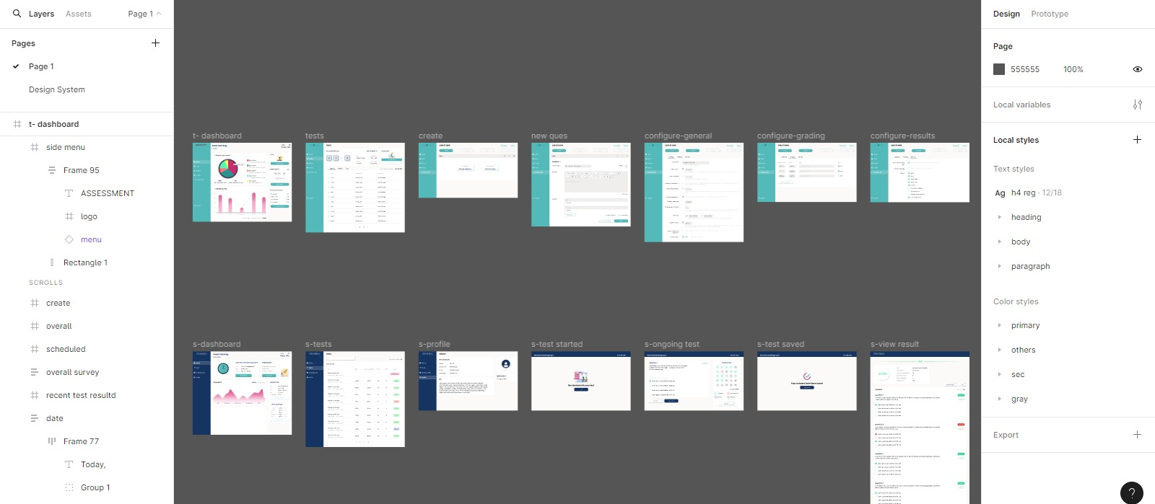
Prototype

Slide 16
Thank You

